Slide 1
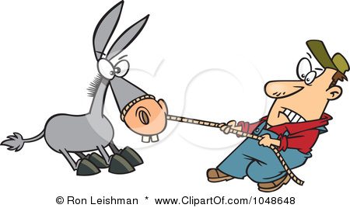
Example of How to Do “A Word Study” for ACDV 70F Vocabulary Final Project
OBSTINATE
grammatical category: adjective
definition: not willing to change one’s opinion, obey, etc.
Greek/Latin roots: ob (meaning against)
other forms: obstinately, obstinacy
sentence: The obstinate boy refused to clean his messy room.
synonyms: stubborn, mulish, recalcitrant
7. antonyms: cooperative, compliant, agreeable
8. PICTURE:

