Slide 1
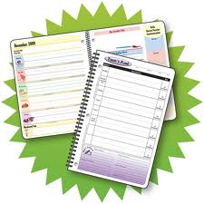
Managing Your Time &
Getting Organized
Workshop
Eileen Pierce

Slide 2
The Challenge
for
Every College Student…
Becoming organized AND staying that way!!
VS.
Note the peaceful, self-satisfied
expression on the face of the
organized person!
Note the tremendous degree
of stress and sense of chaos
that this poor soul is feeling!

Slide 3
To Avoid the Pitfalls
of Being Disorganized…
You must focus on the following:
Your time management tools—the weekly
calendar and the daily TO-DO list
How you organize your folders, binders, &
notebooks
Last but not least, your attitude and degree of
self-discipline

Slide 4
A Quote to Consider
“Know the true value of time. Snatch, seize, and enjoy every moment of it. No idleness, no laziness, no procrastination: never put off till tomorrow what you can do today.”
-- Lord Chesterfield

Slide 5
Setting Up Your Weekly Calendar
Study for a specific class at same time each day
or same time on alternating days.
Use peak-energy times as study periods each day.
When possible, include similar time blocks each day
for family, leisure, meals, & other goals.
Example:
MON.
TUES.
WED.
THURS.
FRI.
SAT.
SUN.
7-8 AM
Eat break-
fast w/ kids
Eat break-
fast w/ kids
8-9 AM
9-10 AM
Psych.,
Study Ch. 2
Psych.,
Study Ch. 2
10-11 AM
Work-
out
Work-
out
Work-
out
History,
Ch. 3

Slide 6
Tips for Making Your Weekly Calendar
(I recommend creating one each Sun. night for
the upcoming week.)
1.Make a list of your fixed activities.
These are activities that don’t change from
week to week. What are some examples?
classes, meetings, appointments, work, etc.
Fill in fixed activities FIRST on your weekly
schedule.
Study most difficult or least-liked subjects
when you’re alert.
Study right before a
class to refresh your
memory for discussion.

Slide 7
Constructing Your Weekly Calendar…cont’d:
Study right after a class to fill in any gaps in
your notes.
Try to plan at
least one study
block every day
of the week.
Plan to study a
subject for
approximately a
50-min. time
block.
*LONG study is
not good for
comprehension,
concentration,
and recall!
*Balance your
time around
school, work, &
personal goals.
*Spreading
study blocks
throughout the
week promotes
better recall.
*After 50 min.,
take a 10-min.
break.

Slide 8
Constructing Your Weekly Calendar…cont’d:
*Avoid marathon studying
(same thing as cramming),
meaning do NOT study
more than 3 hours straight.
2. Next, add flexible study
blocks to your schedule.
Schedule a few study blocks on your Weekly
Calendar that say, “Flex Study.”
*These are a safety net for you in case you get
an unexpected assignment or the need for extra
study arises.
3. Fill in time for family &
leisure (personal time).

Slide 9
Constructing Your Weekly Calendar…cont’d:
Family is very important!
Also, be sure you make time for
yourself, too!
Lastly, don’t forget your
short-term goals & other
responsibilities not related
to school, such as:
cleaning the garage, exercising,
walking the dog, etc.

Slide 10
Experimenting with Your Weekly Calendar:
At the end of your first week, circle or highlight
time blocks that went well, meaning you followed
your plan!
Put an X through any blocks in which you did NOT
do what you had planned.
MON.
TUES.
WED.
THURS.
FRI.
SAT.
SUN.
Eat break-
fast w/ kids
X
7-8 AM
Eat break-
fast w/ kids
8-9 AM
9-10 AM
Psych.,
Study Ch. 2
Psych.,
Study Ch. 2
X
X
X
10-11 AM
Work-
out
Work-
out
Work-
out
History,
Ch. 3

Slide 11
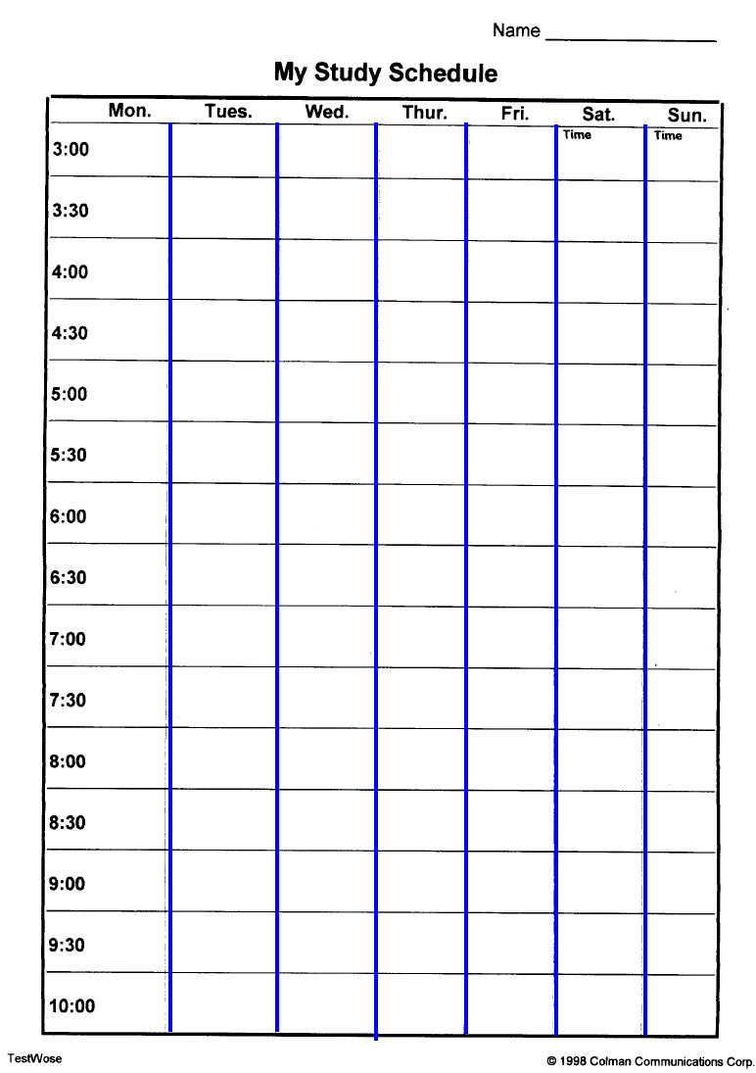
At the end of the first week, reevaluate
your schedule and make appropriate changes.
Save your old schedule &
use it to create future
schedules.
Each week as you refine
your schedule and practice
living by it, you should see
increased success.

Slide 12
Remember to make the Weekly Calendar
work for you!
It is important to be flexible &
willing to try this new system.
It usually takes about 3 weeks to settle
in and start realizing your benefits,
so… don’t give up!
And, remember, that managing time is
a constant, lifelong battle that you will
never be perfect at doing!

Slide 13
Now try it out!
Create your own Weekly Calendar
for this upcoming week.
Follow all the guidelines we just
discussed!
Use the blank template to make
more copies for future use.

Slide 14
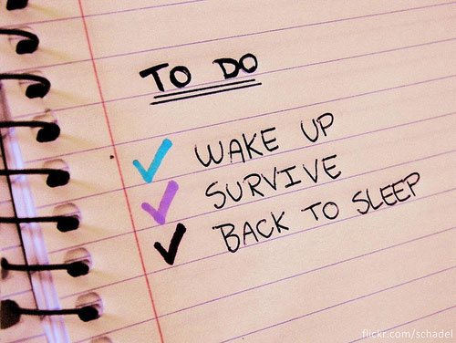
Now we move on to the To-Do List:
What exactly is a
To-Do List? Maybe
I need one!!
*Each morning…list 3-5 actions to accomplish
that day—can be related to any goal you have.
Examples: call dr.’s office for appt.
study Ch. 4-6 for history test
avoid diet coke

Slide 15
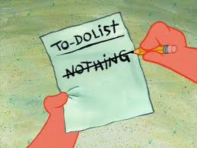
More advice for your To-Do List:
Each day, post it where you can see it!
As you complete each task on the list, cross it
off! Why does this matter?
Every task you complete on your list brings
you that much closer to achieving your long-
term goals.

Slide 16
Getting Organized for Each Class
*DO NOT mix material from different courses—recipe
for disaster!
*Essential items for maximum organization:
--colored folders, one for each class, to hold loose
papers
--one notebook per class for taking lecture notes
--always write date at the top of each set of
lecture notes
--Last but not least…obtain sturdy backpack,
rolling one is best…your back will thank you later on!!

Slide 17
Attitude
The Underlying Ingredient for Success
“Curious (meaning with a positive attitude) learning
not only makes unpleasant things less unpleasant but
also makes pleasant things more pleasant.”
Bertrand Russell

Slide 18
How Do I Develop a Positive Attitude?
Assess attitude toward school & time management.
--Sweet-smelling or foul?
Do NOT dwell on negatives!
--Replace negative thoughts with positive ones.
Appreciate the many opportunities at B.C. & the
privilege of being able to pursue an education.
--So many hands reaching out, but you must complete
the handshake!!
Counseling
Success Lab
Math Lab
Writing Center
Financial Aid
Tutoring

Slide 19
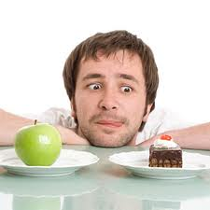
Self-Discipline
The Key to staying Organized
--What is it?...the ability to force yourself to do necessary
tasks, even when you are totally not in the mood
--Do not baby yourself
You have much greater ability
and strength than you’ve ever realized.

Slide 20
The Cultivation of
Self-Discipline
*Maintain a tight grip on your long-term goals.
--Write them down & review them during times of
discouragement.
--NEVER lose sight of where you’re headed.

Slide 21
A Parting Quote…
“The suffering of the moment is as
nothing compared to the immense
joy you’ll feel upon achievement of
your dream.”

